Slide 1
Predictive Underwriting for Pre Existing
By Gopalakrishnan Kumar, MTech IIT-Bombay,
Freelance Data Science Consultant
LinkedIn: Profile Link : https://www.linkedin.com/in/gopalakrishnankumar-a73301110/
Github:https://github.com/Gopal21236/
Kaggle URL- https://www.kaggle.com/gopalkk2

Slide 2
Google Colab URL
https://colab.research.google.com/drive/1bNGTf6S7ON8RpUFQUhOtbioyE8jRt7Aw?usp=sharing

Slide 3
Executive Summary
Insurance underwriting is increasingly challenged by rising healthcare costs, complex medical histories, and regulatory requirements for explainability. Traditional rule-based underwriting struggles to balance risk accuracy, fairness, and scalability.
This project develops a predictive underwriting framework for pre-existing conditions using data analytics and machine learning. The model segments policyholders by medical risk, supports transparent decision-making, and enables insurers to optimize pricing, risk selection, and portfolio management.

Slide 4
Business Problem Definition
Insurers face the following underwriting challenges:
Rising claims due to chronic and critical pre-existing conditions
Limited ability to accurately price medical risk at scale
Regulatory pressure for explainable and auditable decisions
Portfolio risk concentration without clear visibility into drivers
Without analytics-driven underwriting, insurers risk adverse selection, pricing inefficiencies, and compliance exposure.

Slide 5
Project Objectives
The objectives of this project are to:
Predict underwriting risk based on pre-existing medical conditions
Segment policyholders into low, moderate, and high-risk categories
Support transparent and explainable underwriting decisions
Enable portfolio-level risk analytics and monitoring
Provide data-driven inputs for pricing and risk management

Slide 6
Data Description and Features
The underwriting dataset includes the following key features:
Age
Body Mass Index (BMI)
Smoking indicator
Hypertension indicator
Diabetes indicator
Prior claims count
These variables capture medical severity, lifestyle risk, and historical utilization, which are central to underwriting decisions.

Slide 7
Modeling Approach
A logistic regression model was used to classify policyholders into high-risk and low-risk categories.
Why Logistic Regression?
Interpretable and regulator-friendly
Supports probability-based decision thresholds
Easy to explain to business and compliance teams
The model outputs:
Risk classification (High / Low)
Probability of high underwriting risk

Slide 8
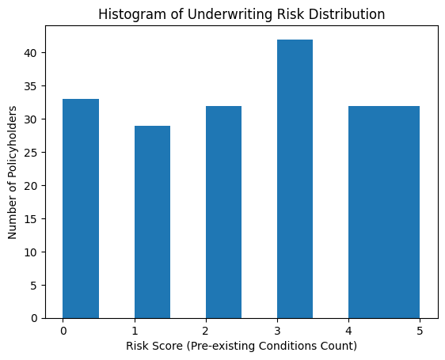
Data Visualization

Slide 9
Visualization and Analytics
Visualization techniques were applied to translate model outputs into actionable insights.
6.1 Histogram Analysis
The histogram shows the distribution of underwriting risk scores across policyholders. Most customers fall into mid-risk ranges, while fewer customers occupy extreme high-risk buckets.
Insight: The portfolio is not overly skewed toward high-risk customers, indicating balanced risk exposure.

Slide 10
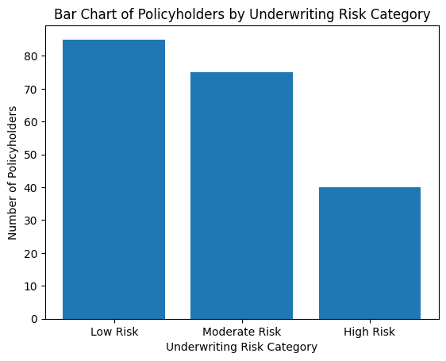
Data Visualization

Slide 11
Visualization and Analytics
6.3 Stacked Bar Chart Analysis
The stacked bar chart decomposes each risk category by type of pre-existing condition (lifestyle, chronic, critical).
Insight:
Low risk is driven mainly by lifestyle conditions
Moderate risk is dominated by chronic conditions
High risk has a higher share of critical conditions
This improves explaina
bility by showing why customers fall into specific risk buckets.

Slide 12
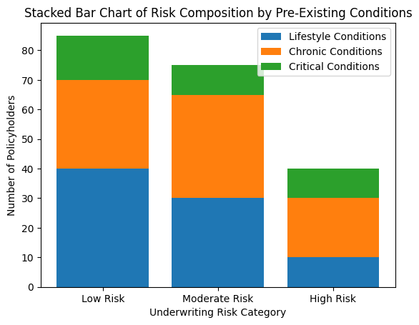
Data Visualization

Slide 13
Visualization and Analytics
6.3 Stacked Bar Chart Analysis
The stacked bar chart decomposes each risk category by type of pre-existing condition (lifestyle, chronic, critical).
Insight:
Low risk is driven mainly by lifestyle conditions
Moderate risk is dominated by chronic conditions
High risk has a higher share of critical conditions
This improves explainability by showing why customers fall into specific risk buckets.

Slide 14
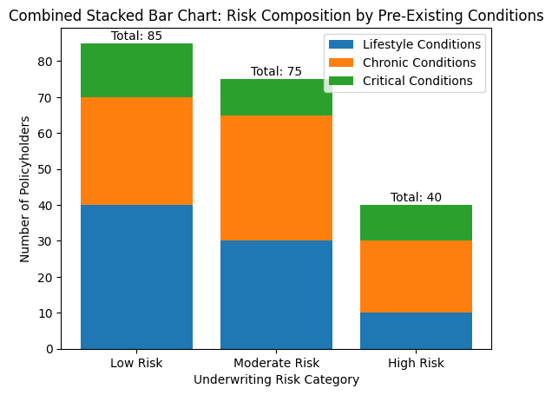
Data Visualization

Slide 15
Visualization and Analytics
6.4 Combined Stacked Bar Chart Analysis
The combined stacked bar chart integrates total policyholder volume with condition composition and annotated totals.
Insight: Risk escalation is visible not only in volume but also in severity. High-risk categories show disproportionate contributions from critical conditions, justifying premium loading and underwriting constraints.

Slide 16
Key Insights
Pre-existing conditions significantly influence underwriting risk
Chronic and critical conditions drive high-risk classifications
Explainable models improve regulatory acceptance
Visualization enhances underwriting transparency
Portfolio-level analytics support risk appetite management

Slide 17
Business Impact
This predictive underwriting framework enables insurers to:
Improve pricing accuracy and premium differentiation
Reduce adverse selection and claim volatility
Enhance transparency for regulators and auditors
Monitor portfolio risk in real time
Scale underwriting decisions consistently
Overall, the solution aligns underwriting decisions with both profitability and compliance objectives.

Slide 18
Limitations
Uses simulated data rather than production claims data
Does not include advanced models (e.g., gradient boosting)
No real-time integration with policy administration systems

Slide 19
Future Enhancements
Potential enhancements include:
Advanced ML models with explainability techniques (SHAP)
Integration with claims and policy systems
Dynamic premium optimization
Real-time underwriting decision engines

Slide 20
Conclusion
This project demonstrates how predictive analytics can modernize underwriting for pre-existing conditions. By combining interpretable models with visualization-driven analytics, insurers can make transparent, scalable, and defensible underwriting decisions. The approach aligns strongly with modern actuarial practices and consulting-grade decision science.

